Slide 1

Topic for the class: Introduction to Hidden Markov Models Date & Time : 17-11-20 & 3.00 - 4.00PM
P.Praveena
Assistant Professor
Department of Computer Science and Engineering
GITAM Institute of Technology (GIT)
Visakhapatnam – 530045
Email: ppothina@gitam.edu

Slide 2
CONTENTS
• Introduction
• Markov Model
• Hidden Markov model (HMM)
• Three central issues of HMM
– Model evaluation
– Most probable path decoding
– Model training
•
Application Areas of HMM

Slide 3
How do a person know his/her spouse is happy or not? Any couple will tell you it can be hard.
In machine learning ML, many internal states are hard to determine or observe. An alternative is to determine them from observable external factors. That is what HMM solves.
For example, in speech recognition, we listen to a speech (the observable) to deduce its script (the internal state representing the speech).
Take mobile phone’s on-screen keyboard as an example, you may sometimes mistype the character next to what you wanted to. Here, the character you mistype is the observed data, and the one that you intended to type in your mind is the unobserved one.
There are many cases that what is observed is not the truth, and the Hidden Markov Model is one way that could give us the hidden truth back.

Slide 4
In probability theory, a Markov model is a stochastic model used to model randomly changing systems. It is assumed that future states depend only on the current state, not on the events that occurred before it.
Hidden Markov Model (HMM) is a statistical Markov model in which the system being modeled is assumed to be a Markov process – call it – with unobservable ("hidden") states. HMM assumes that there is another process whose behavior "depends" on . The goal is to learn about by observing .
Markov model is a state machine with the state changes being probabilities. In a hidden Markov model, you don't know the probabilities, but you know the outcomes.

Slide 5
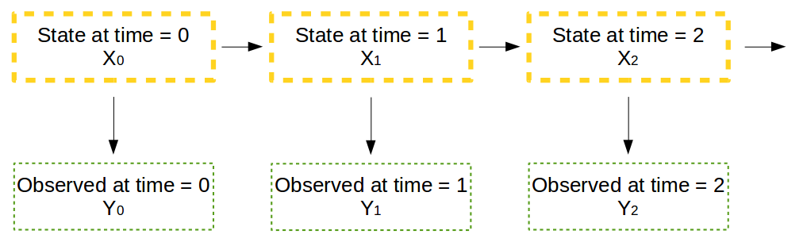
In either of the examples above, we are actually dealing with data sequences.
For example, we may mistype ‘miscellaneous’ as ‘miscellameous’ which are actually both sequences of characters.
Here, for each observed data, we have an associated hidden truth. In formal HMM discussion, people call each ‘hidden truth’ as a ‘state variable’, and each ‘observed data’ as a ‘observed variable’.
HMM. The above orange boxes are ‘linked’ with one another to form a Markov chain. Each state in the chain is ‘linked’ to an observed variable.

Slide 6
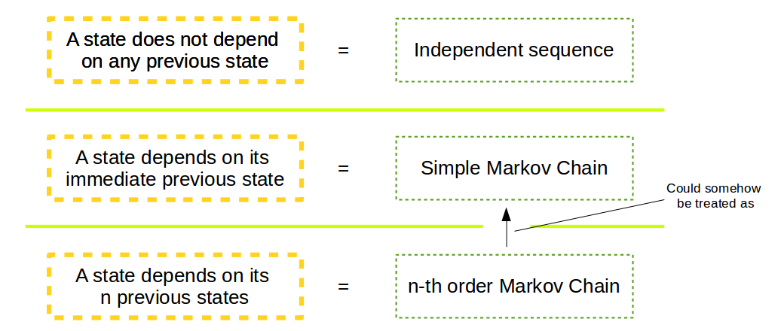
In the above HMM architecture, we have a sequence of states (hidden truths) ‘linked’ with each other. For example, the state at time = 1 depends on the state at time = 0.
This is the very important assumption in the Markov model that makes it so simple — ”any state depends ONLY on some of its previous state(s).”
We call it a simple Markov chain if a state depends on its first previous state, whereas it is a n-th order Markov chain if a state depends on its first n previous states.

Slide 7
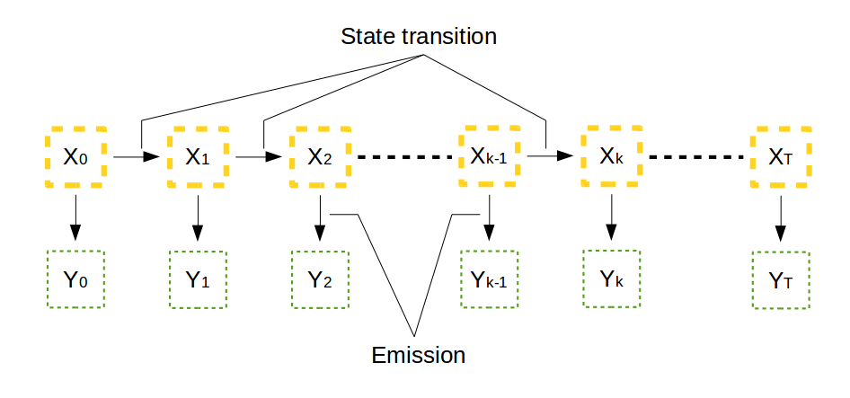
State transition, emission, and initial state:
state transition, which is the transition from the state at time k-1 to the time k, or the change from one orange box to the next.
Assume there are M possible states to choose from, namely, the state could be any one of {1, 2, 3, …, m}.
And we could quantify the transition probability from state i to state j as aᵢⱼ. Since the transition could happen from any one of the M possible states to another one of the M possible states, there are in total M × M possibilities. And we could arrange them in the following matrix representation, which is called the state transition matrix A.

Slide 8
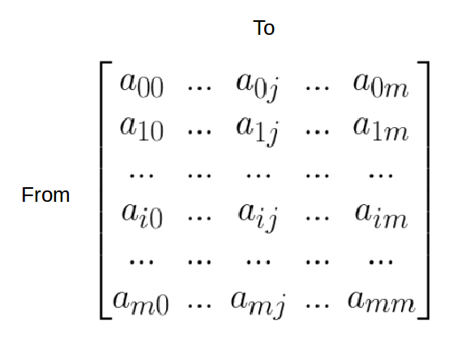

Because all aᵢⱼ are probability values, they are all bounded to be between 0 and 1, and each row has to be summed to 1.
aᵢⱼ represents the probability of state j given state i

Slide 9
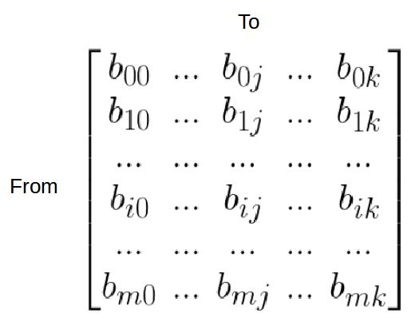

Similarly, we could construct the emission matrix B for storing the probabilities of a state i resulting in an observed value j.
Here, the observable is assumed to have K possible values, meaning it could take any one of the {1, 2, …, k }.
emission matrix B. bᵢⱼ represents the probability of state i to emit observable j.
bᵢⱼ represents the probability of observing j given state i

Slide 10
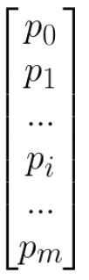
Now we have the architecture, the state transition matrix A, and the emission matrix B.
The last thing that we will need is the probability distribution π₀ of the initial state X₀.
We need it to start the first state, so the upcoming states in the Markov chain could be estimated by the state transition matrix.
initial state distribution π₀.

Slide 11
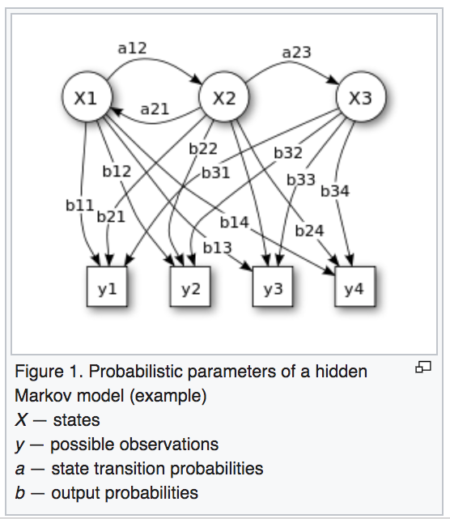

Slide 12
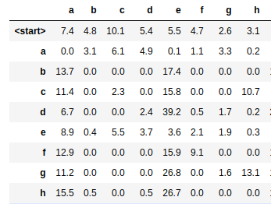
let us look at the following example about words. Here taken 3000 words list from the Oxford Advanced Learner’s Dictionary and tabulate the probability of having a character as the starting character, and the probability of a character coming after another.
The first row of the table gives us the initial state distribution π₀, and the rest form the state transition matrix A.
For the emission matrix B, let’s argue that 70% of time a user type a character correctly, otherwise a neighbor character is typed. For example, if we intend to type ‘G’ (state), then there is 70% we correctly type ‘G’ (observed), and there is 30% to get any one of {‘T’, ‘Y’, ‘F’, ‘H’, ‘C’, ‘V’, ‘B’}, or ~4.2% each. By this argument, we could construct the emission matrix.

Slide 13

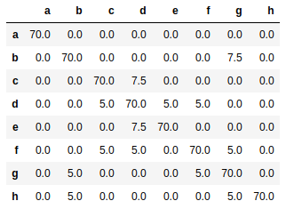
a keyboard example :
Only a partial table is shown here, and all values are in percentage. This table form the emission matrix. For example, there is 5% chance that intentionally typing ‘d’ (state) will result in ‘c’ (observed).

Slide 14
Hidden Markov Models
A hidden Markov model (HMM) is a statistical model,in which the system being modeled is assumed to be a Markov process (Memoryless process: its future and past are independent ) with hidden states.
^{λ} Hidden Markow Models:
–

Slide 15
Hidden Markov Models
^{λ} Hidden Markow Models:
– Has a set of states each of which has limited number of transitions and emissions,
Each transition between states has an assisgned probability,
Each model strarts from start state and ends in end state,
–
–

Slide 16
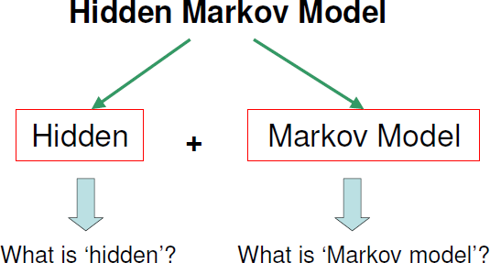
Hidden Markov Models
The reason it is called a Hidden Markov Model is because we are constructing an inference model based on the assumptions of a Markov process. The Markov process assumption is simply that the “future is independent of the past given the present”. In other words, assuming we know our present state, we do not need any other historical information to predict the future state.

Slide 17
Markov Property
• Markov Property: The state of the system at time t+1
depends only on the state of the system at time t
X_{t=1}
X_{t=2}
X_{t=3}
X_{t=4}
X_{t=5}

Slide 18
Markov Chains
Stationarity Assumption
Probabilities independent of t when process is “stationary”
So,
This means that if system is in state i, the probability that
the system will next move to state j is p_{ij} , no matter what
the value of t is

Slide 19



Hidden Markov Models
^{λ} Markov Models :
λ
λ
Talk about weather,
Assume there are three types of weather:
– Sunny,
–
Rainy,
–
Foggy.

Slide 20
Markov Models
λ
Weather prediction is about the what would be the weather tomorrow,
– Based on the observations on the past.

Slide 21
Markov Models
_{λ Weather at day n is} q_{n} ∈{sunny ,rainy , foggy}
–
q_{n} depends on the known weathers of the past days (q_{n-1}, q_{n-2},…)

Slide 22
Markov Models
^{λ} We want to find that:
–
means given the past weathers what is the probability of any possible weather of today.

Slide 23


Markov Models
^{λ} Markow Models:
^{λ} For example:
^{λ} if we knew the weather for last three days was:
^{λ} the probability that tomorrow would be
P(q₄ = | q₃ = q₂ = q₁ =
is:
,
,
)

Slide 24
Markov Models
^{λ} Markow Models and Assumption (cont.):
– Therefore, make a simplifying assumption Markov assumption:
^{λ} For sequence:
^{λ} the weather of tomorrow only depends on today
(first order Markov model)

Slide 25
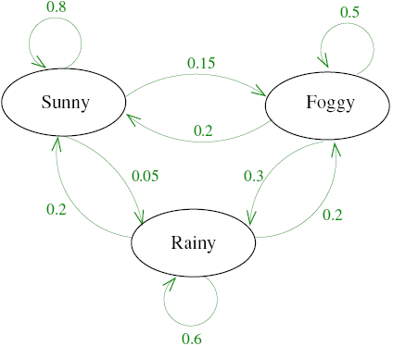
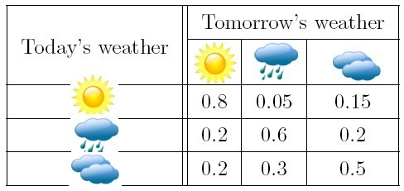
Markov Models
^{λ} Markow Models and Assumption (cont.):
Examples:
^{λ} HMM:

Slide 26
Markov Models
^{λ} Markow Models and Assumption (cont.):
Examples:
^{λ} If the weather yesterday was rainy and today is foggy what is the probability that tomorrow it will be sunny?

Slide 27

Markov Models
^{λ} Markow Models and Assumption (cont.):
– Examples:
^{λ} If the weather yesterday was rainy and today is foggy what is the probability that tomorrow it will be sunny?
Markov assumption

Slide 28
Hidden Markov Models
^{λ} Hidden Markov Models (HMMs):
– What is HMM:
^{λ} Suppose that you are locked in a room for several days,
^{λ} you try to predict the weather outside,
^{λ} The only piece of evidence you have is whether the person who comes into the room bringing your daily meal is carrying an umbrella or not.

Slide 29
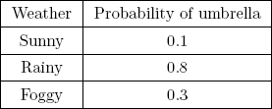

Hidden Markov Models
^{λ} Hidden Markov Models (HMMs):
– What is HMM (cont.):
^{λ} assume probabilities as seen in the table:

Slide 30
Hidden Markov Models
^{λ} Hidden Markov Models (HMMs):
– What is HMM (cont.):
^{λ} Finding the probability of a certain weather
q_{n} ∈{sunny ,rainy , foggy}
^{λ} is based on the observations x_{i}:

Slide 31

Hidden Markov Models
^{λ} Hidden Markov Models (HMMs):
– What is HMM (cont.):
^{λ} Using Bayes rule:
^{λ} For n days:

Slide 32
Hidden Markov Models
^{λ} Hidden Markov Models (HMMs):
– Examples:
^{λ} Suppose the day you were locked in it was sunny. The next day, the caretaker carried an umbrella into the room.
^{λ} You would like to know, what the weather was like on this second day.

Slide 33
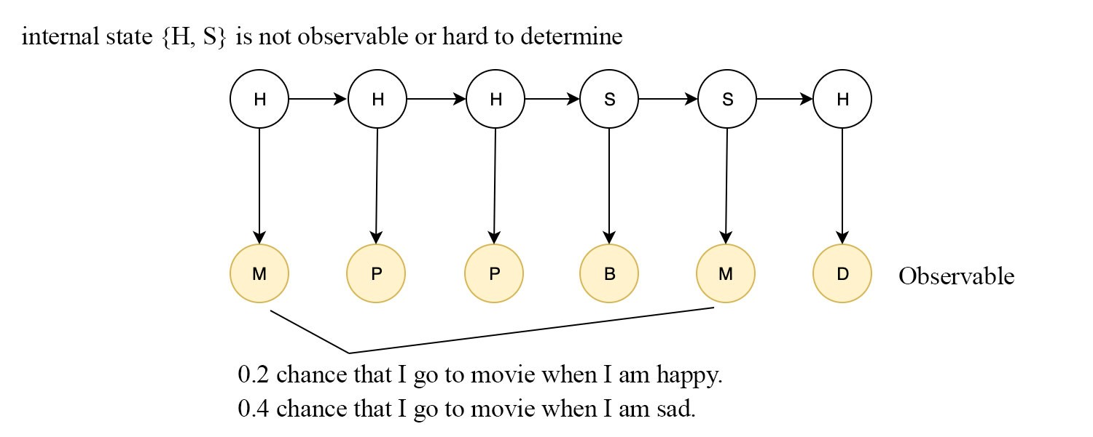
For example, if I am happy, there is a 40% chance that I will go to a party.
But there is a 10% chance that I will be found at a party when I am sad too.
With HMM, we determine the internal state (happy or sad) by making observations

Slide 34
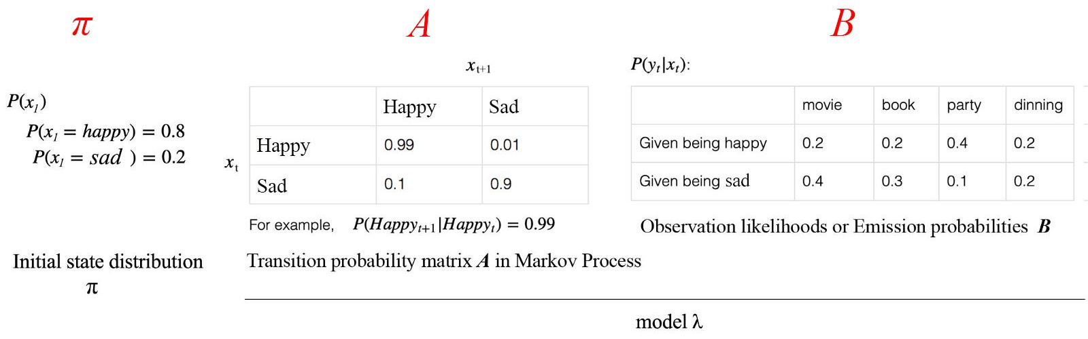
HMM models a process with a Markov process.
It includes the initial state distribution π (the probability distribution of the initial state)
The transition probabilities A from one state (xt) to another.
HMM also contains the likelihood B of the observation (yt) given a hidden state. Matrix B is called the emission probabilities. It demonstrates the probability of our observation given a specific internal state.
The complexity of the problem is that the same observations may be originated from different states (happy or not).

Slide 35

Two major assumptions are made in HMM. The next state and the current observation solely depend on the current state only.
Given all the observable and the initial state distribution, we can compute a pretty complex equation for the probability for the internal state xt
i.e. P(xt| y₁, y₂, y₃, … , yt) at time t.
For simplicity here, we will not include π in our equation. All equations assume π is a given condition, like P(y) → P(y|π).

Slide 36
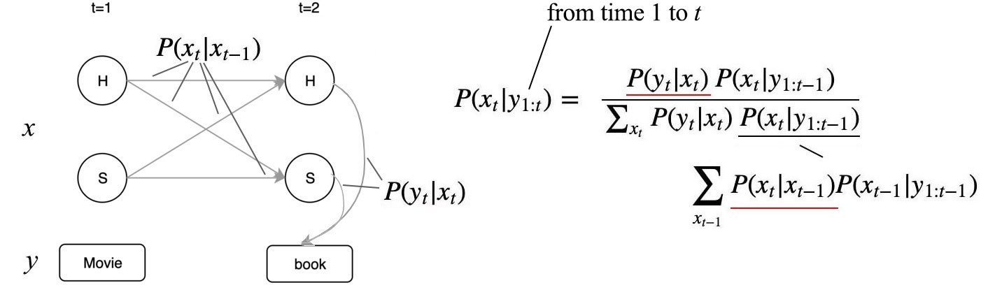
The equation above uses the transition probability and the emission probability to compute the probability of the internal state based on all observations.

Slide 37
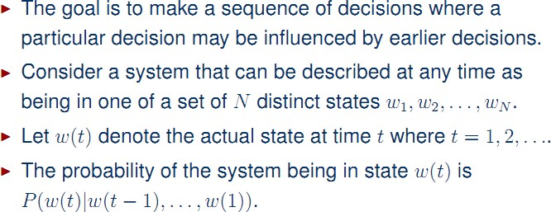
Discrete Markov Processes (Markov Chains)

Slide 38
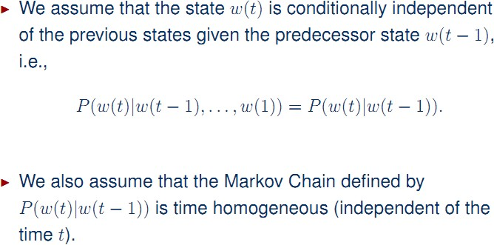
Hiddden Markov Models

Slide 39
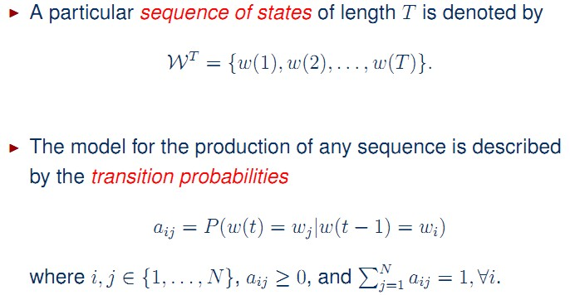
Hidden Markov Models

Slide 40
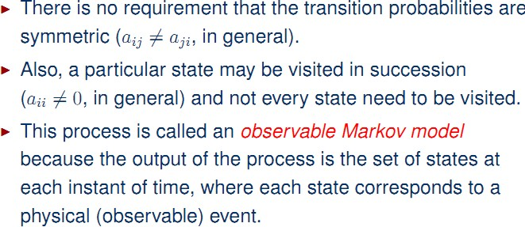
Hidden Markov Models

Slide 41
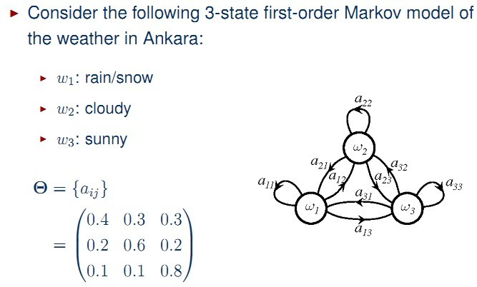
Hidden Markov Model Examples

Slide 42
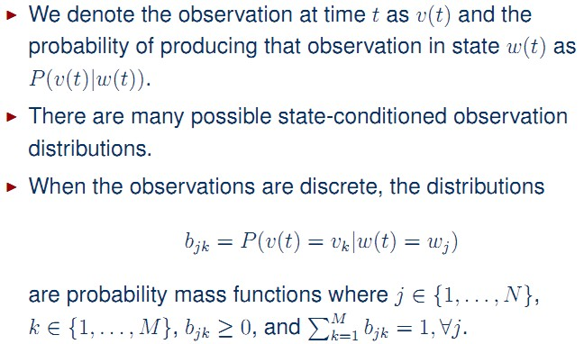
Hidden Markov Models

Slide 43
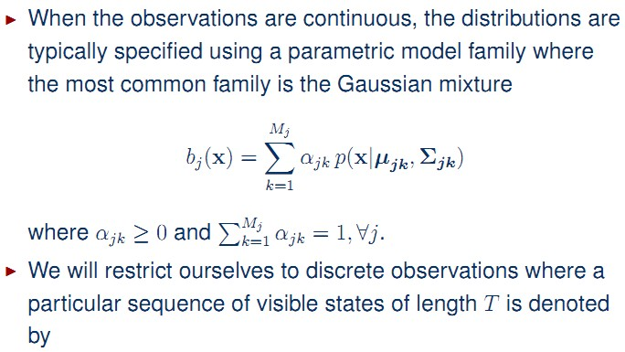

Hidden Markov Models

Slide 44
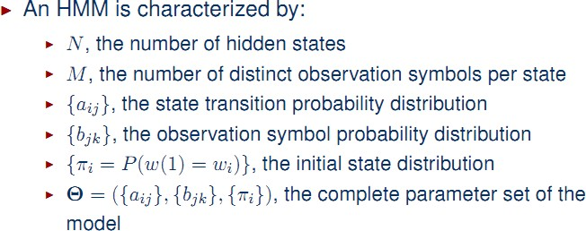
Hidden Markov Models

Slide 45
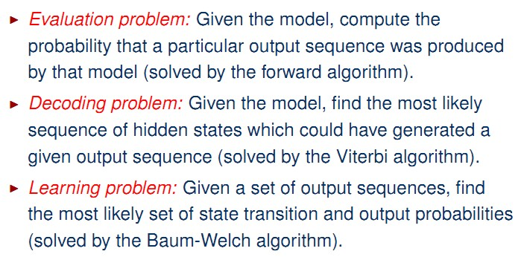
Three Fundamental Problems for HMMs

Slide 46
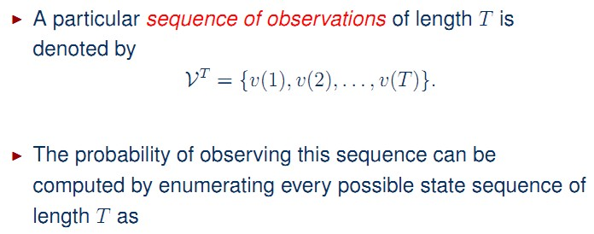
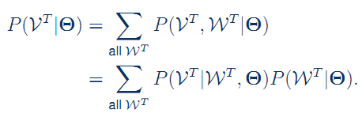
HMM Evaluation Problem
Likelihood: How likely are the observations based on the current model or the probability of being at a state at a specific time step.

Slide 47
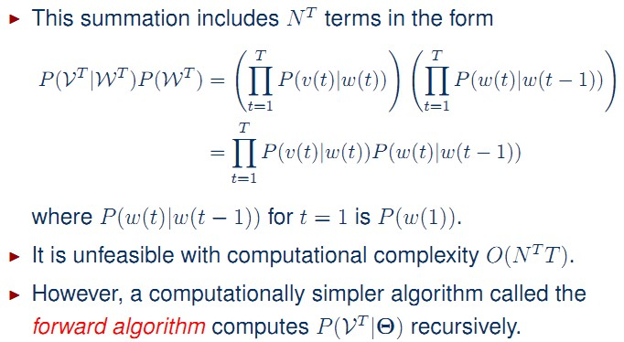
HMM Evaluation Problem

Slide 48
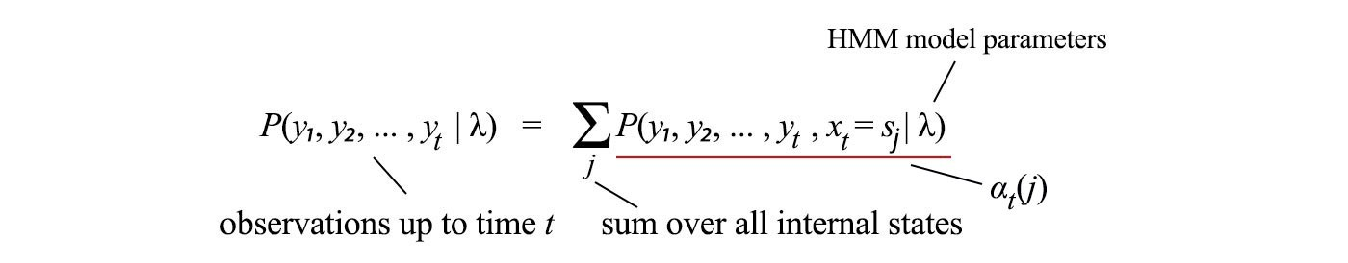
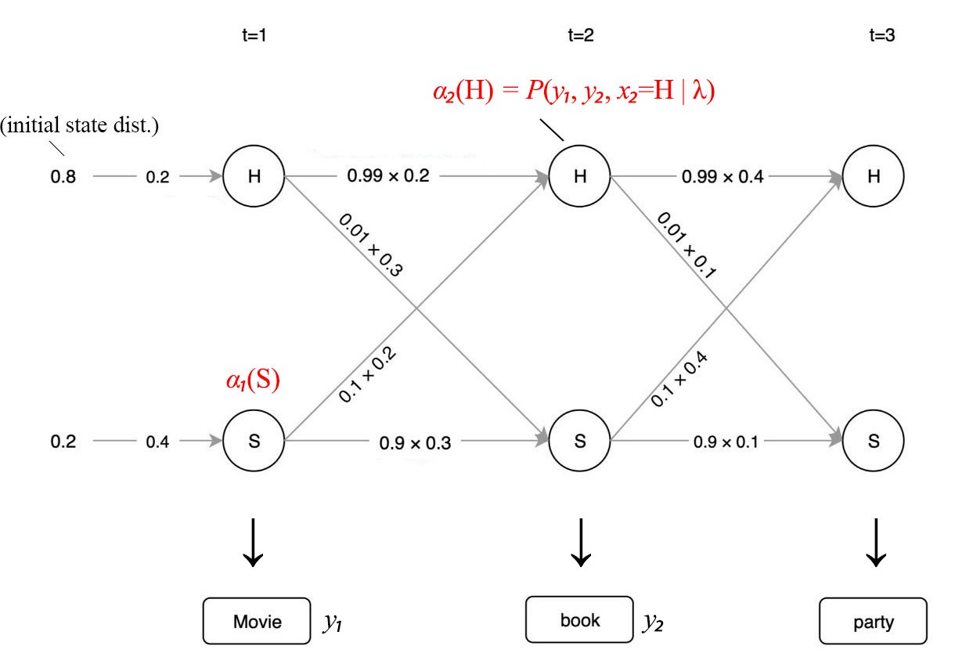
HMM Evaluation Problem
Let’s rename the term underlined in red above as αt(j) (forward probability) and check if we can express it recursively.

Slide 49
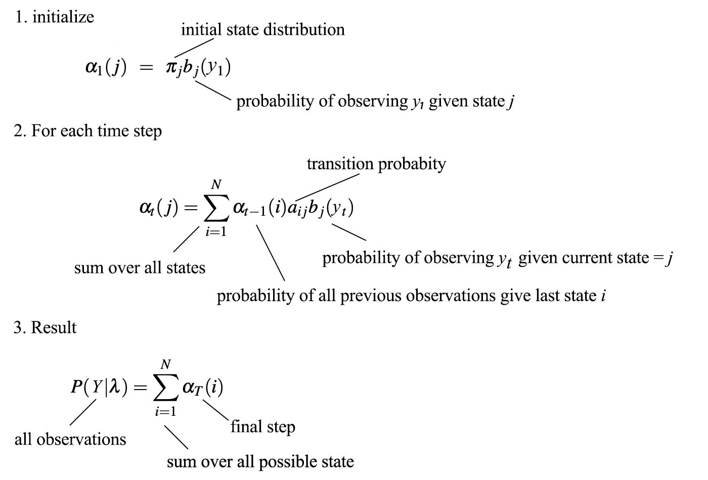
The likelihood of the observations can be calculated recursively for each time step below:

Slide 50
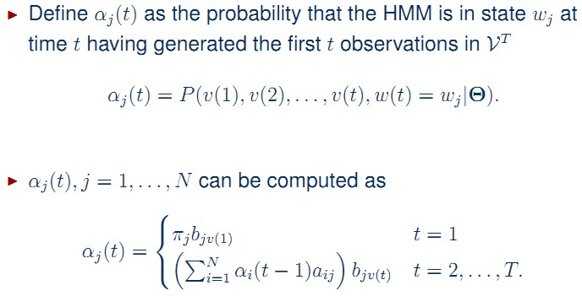


Slide 51
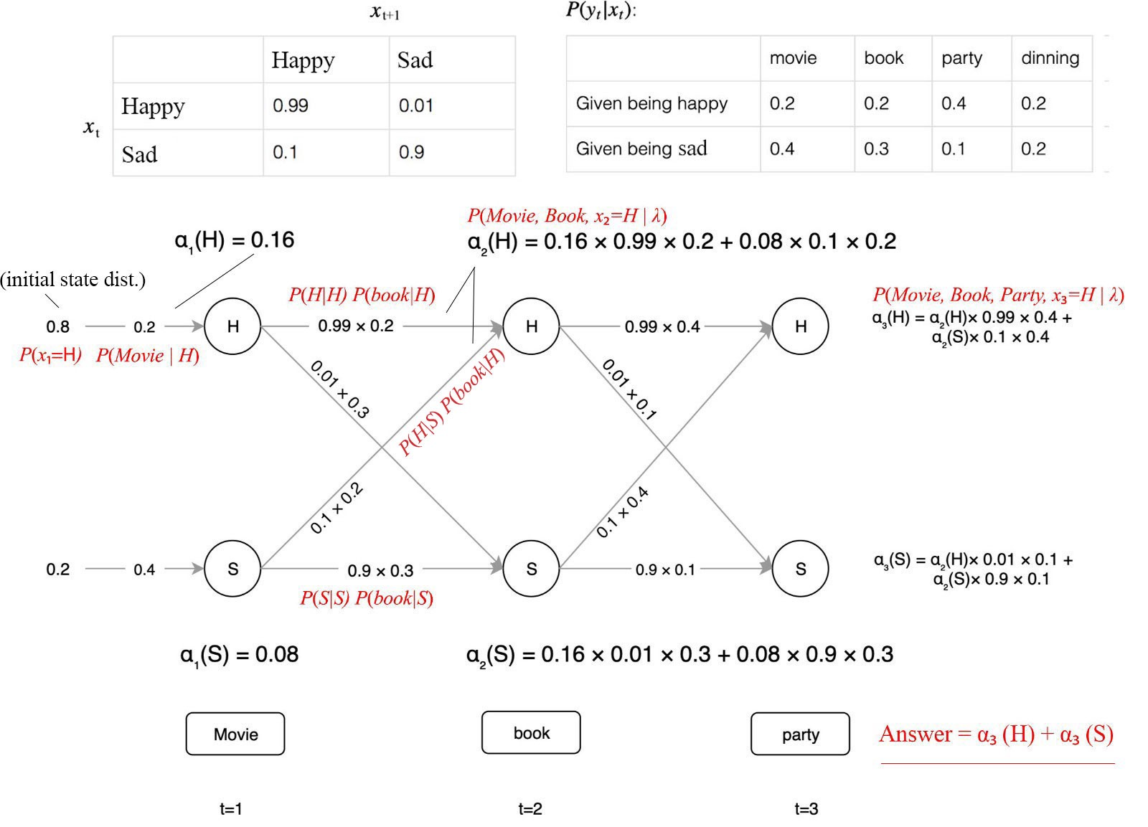
Below is an example which we start with the initial state distribution on the left. Then we propagate the value of α to the right for each timestep. Therefore, we break the curse of exponential complexity.

Slide 52
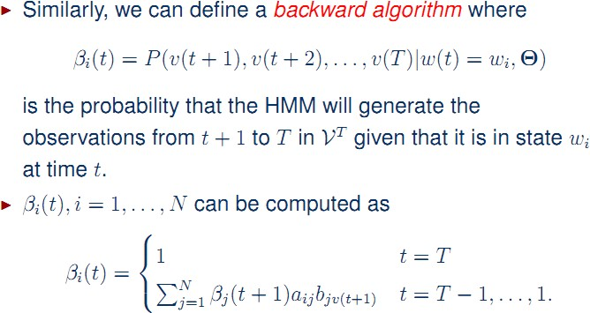
HMM Evaluation Problem

Slide 53
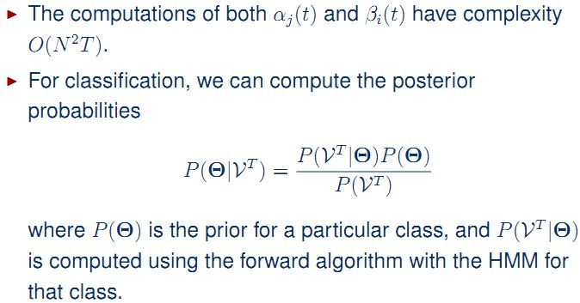
HMM Evaluation Problem

Slide 54
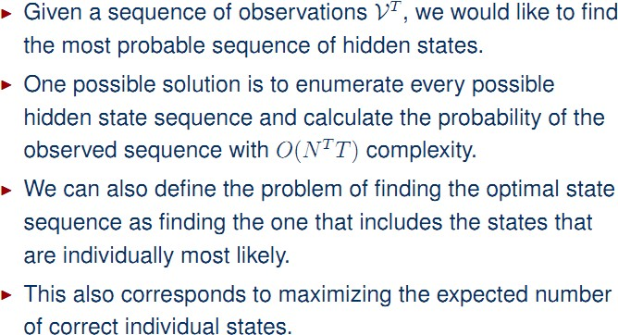
HMM Decoding Problem

Slide 55

Decoding (find the internal states — Viterbi algorithm)
The decoding problem is finding the optimal internal states sequence given a sequence of observations.
Again, we want to express our components recursively. Given the state is j at time t, vt(j) is the joint probability of the observation sequence with the best state sequence.
If we examine closely, the resulting equation is close to the forward algorithm except the summation is replaced by the max function.
So not only it can be done, the solution is similar to the forward algorithm except the summation is replaced by the maximum function. Here, instead of summing over all possible state sequences in the forward algorithm, the Viterbi algorithm finds the most likely path.

Slide 56
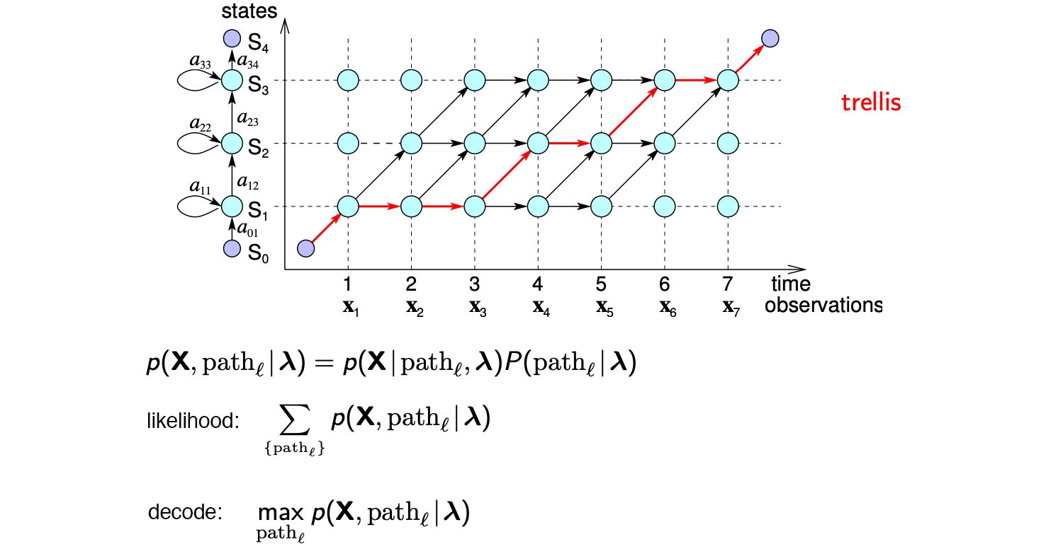
As shown above, finding the internal states that maximize the likelihood of observations is similar to the likelihood method. We just replace the summation with the maximum function.

Slide 57
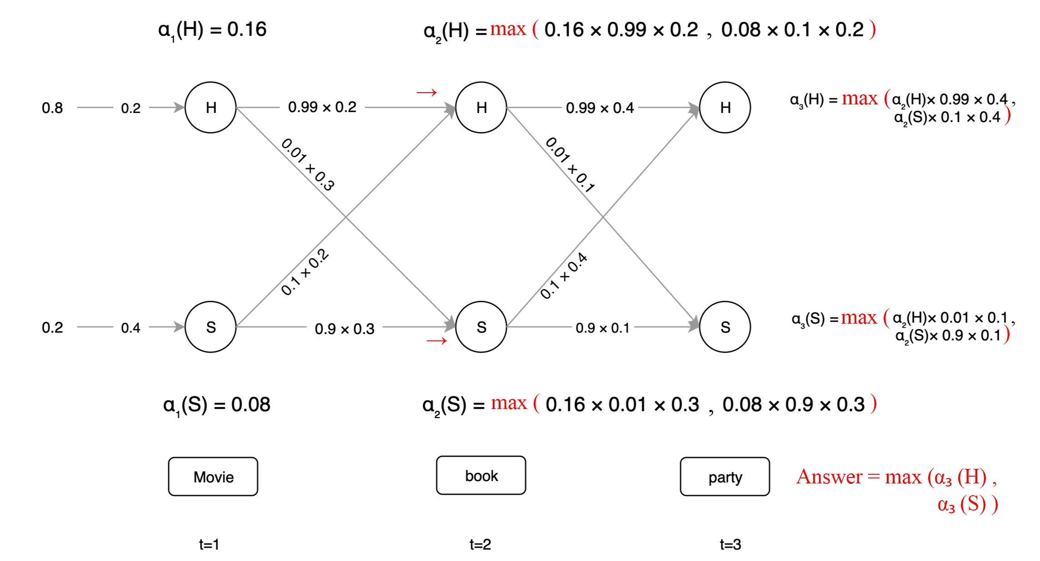

Slide 58
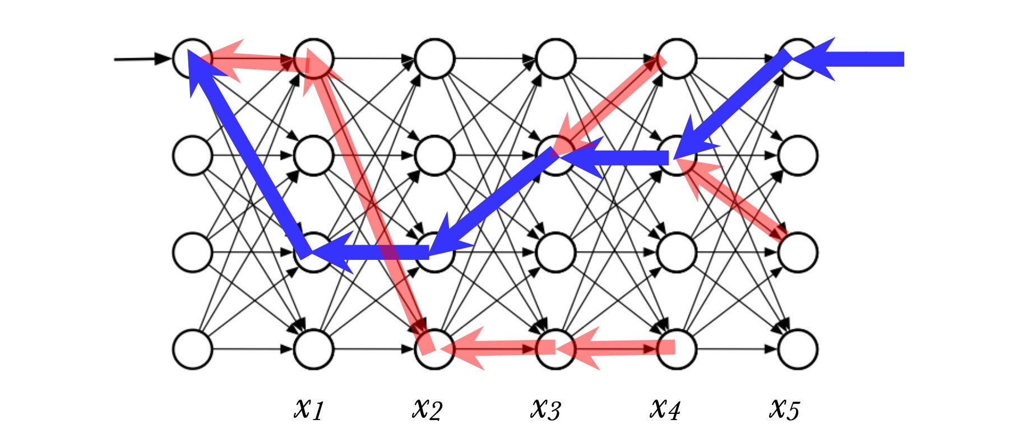
In this algorithm, we also record the maximum path leading to each node at time t (the red arrow above). e.g. we are transited from a happy state H at t=1 to the happy state H at t=2 above since it is the most optimal (likely) path.

Slide 59
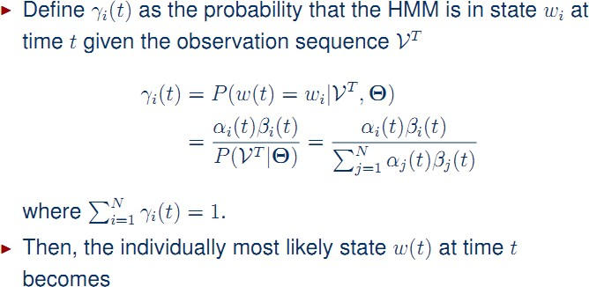

HMM Decoding Problem

Slide 60
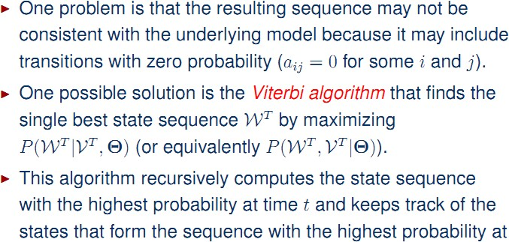
HMM Decoding Problem

Slide 61
Learning (Baum–Welch algorithm — build the model)
Besides likelihood and decoding, the last algorithm learns the HMM model parameters λ given the observation.
Here, we will use the Baum–Welch algorithm to learn the transition and the emission probability.
This task sounds mission impossible since both probabilities are highly tangled in our calculation. But, if we know the state occupation probability (the state distribution at time t), we can derive the emission probability and the transition probability.
If we know these two probabilities, we can derive the state distribution at time t.
This is like the chicken and egg problem.

Slide 62

To learn the HMM model, we need to know what states we are to explain the observations the best.
That will be the occupation probability γ — the probability of state i at time t given all the observations.
Given the HMM model parameters fixed, we can apply the forward and backward algorithm to calculate α and β from the observations.
γ can be calculated by simply multiplying α with β, and then renormalize it.

Slide 63
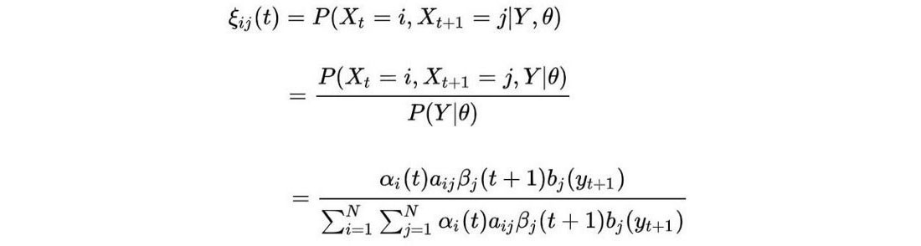

ξ is the probability of transiting from state i to j after time t given all the observations. It can be computed by α and β similarly.
Intuitively, with a fixed HMM model, we refine the state occupation probability (γ) and the transition (ξ) with the given observations.

Slide 64


Here comes the chicken and egg part. Once the distribution of γ and ξ (θ₂) are refined, we can perform a point estimate on what will be the best transition and emission probability (θ₁: a, b).
We fix one set of parameters to improve others and continue the iteration until the solution converges.

Slide 65
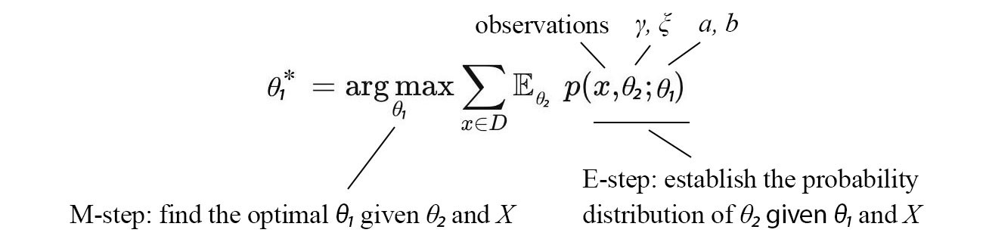
It is not surprising that the Baum–Welch algorithm is an EM algorithm.
Here, the E-step establishes p(γ, ξ | x, a, b). Then, the M-step finds a, b that roughly maximizes the objective below.

Slide 66
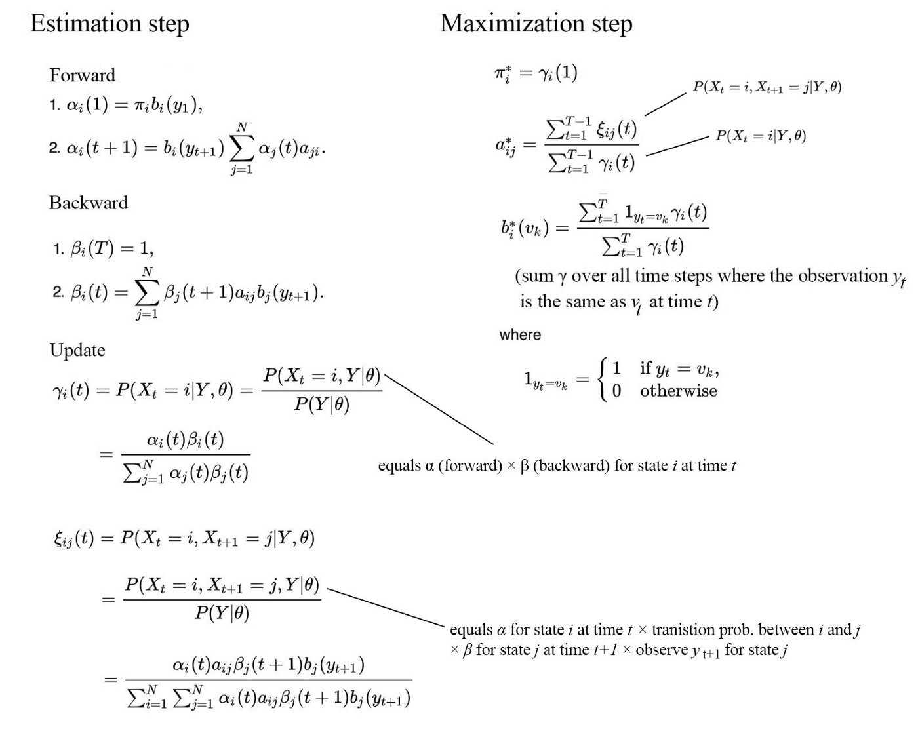
Here is the algorithm:

Slide 67
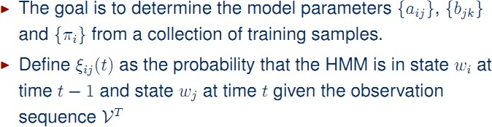
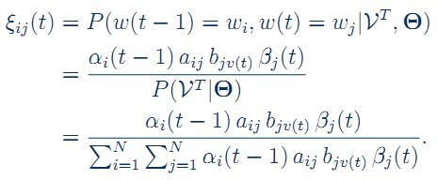
HMM Learning Problem

Slide 68
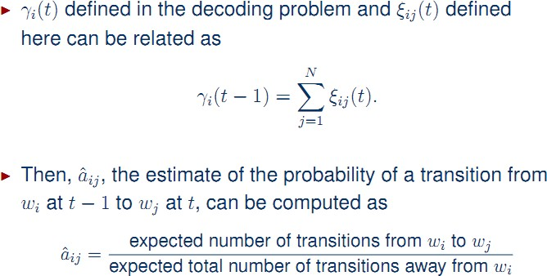

HMM Learning Problem

Slide 69
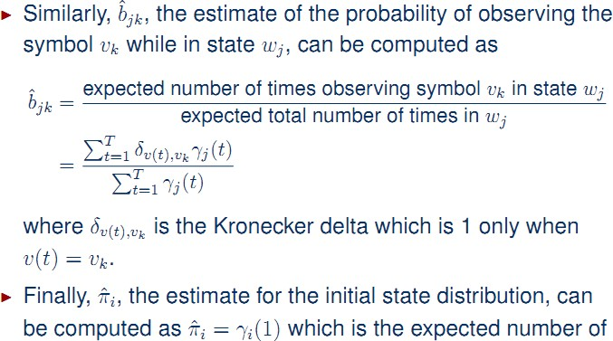
HMM Learning Problem

Slide 70
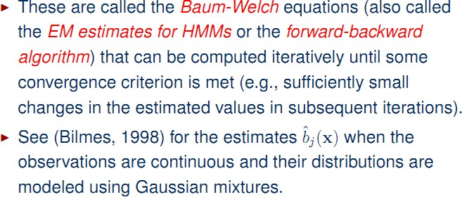
HMM Learning Problem

Slide 71
Application Areas of HMM
• On-line handwriting recognition
• Speech recognition
• Gesture recognition
• Language modeling
• Motion video analysis and tracking
• Stock price prediction and many more….

